Slide 1


DATATECH LABS.
Data Engineering Course.
Week 2: Data Pipelines and Big Data Processing

Slide 2
Outline: Week 2
ETL (Extract, Transform, Load) Processes
Data Pipeline Design
ETL Tools and Frameworks
Introduction to Big Data
Hadoop Ecosystem: HDFS, MapReduce, YARN
Apache Spark
DATATECH LABS.

Slide 3
ETL and Data Pipelines
DATATECH LABS.

Slide 4
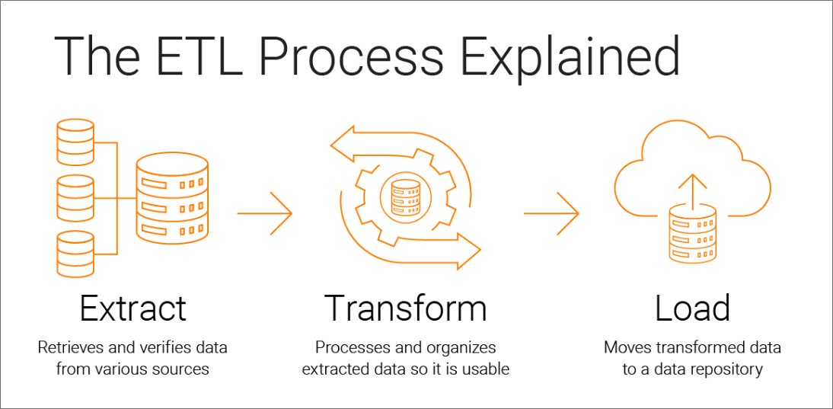
What is ETL?
Definition: ETL stands for Extract, Transform, Load.
It is a data integration process that involves:
Extract: Pulling data from various sources.
Transform: Converting the data into a format suitable for analysis.
Load: Storing the transformed data into a data warehouse or database.
DATATECH LABS.

Slide 5

The Importance of ETL in Data Engineering
ETL processes are critical for ensuring that data is accessible, accurate, and usable for decision-making.
They allow businesses to integrate data from disparate sources and prepare it for analysis.
Discussion Point: What are the potential challenges in each step of the ETL process?
DATATECH LABS.

Slide 6
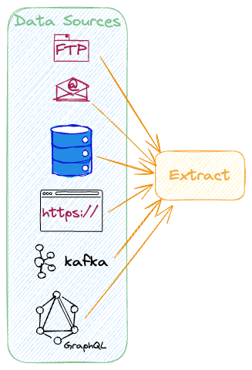
Components of ETL: Extraction
Data Extraction:
Common sources: databases queries, APIs, flat files, etc.
Data extraction techniques:
Full extraction
incremental extraction
Update notification
Challenges:
Data volume and velocity (Complex data sources)
Variety of data sources for the same application
Data format inconsistencies
Data quality issues at source
DATATECH LABS.

Slide 7
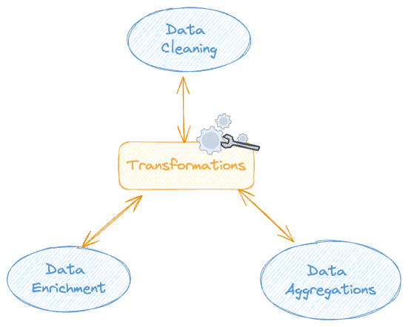
Components of ETL: Transformation
Types of Transformations:
Data cleaning: Removing duplicates, handling missing values.
Data standardization: Consistent naming conventions, Data type conversion, ..
Data enrichment: Adding context to raw data, combining data from multiple sources, adding derived columns.
Data transformation: Aggregation, sorting, joining datasets,
Challenges:
Handling missing data
Dealing with duplicates.
DATATECH LABS.

Slide 8
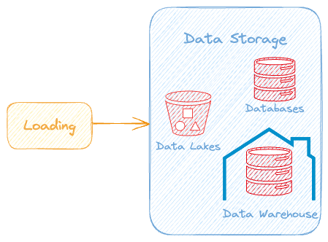
Components of ETL: Loading
Loading data into target systems like:
Databases
Data warehouses
Data lakes.
Data Loading Considerations
Data volume
Loading frequency
Target system constraints
Data integrity and consistency
Error handling and recovery
DATATECH LABS.

Slide 9
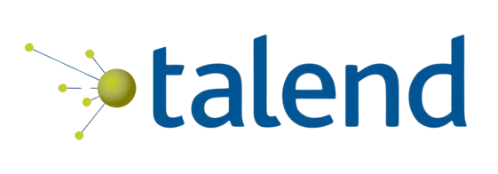


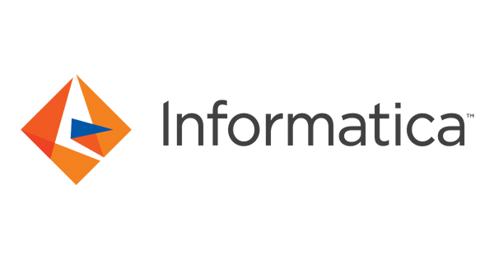
ETL Tools and Frameworks
Native Code script: Using one of the programming languages to write the ETL logic, like Python, or Java.
Apache NiFi: A powerful data integration tool that supports data routing, transformation, and system mediation.
Talend: An open-source ETL tool that provides a comprehensive set of tools for data integration.
Informatica: A widely used enterprise ETL tool that provides data integration solutions for various types of data.
DATATECH LABS.

Slide 10
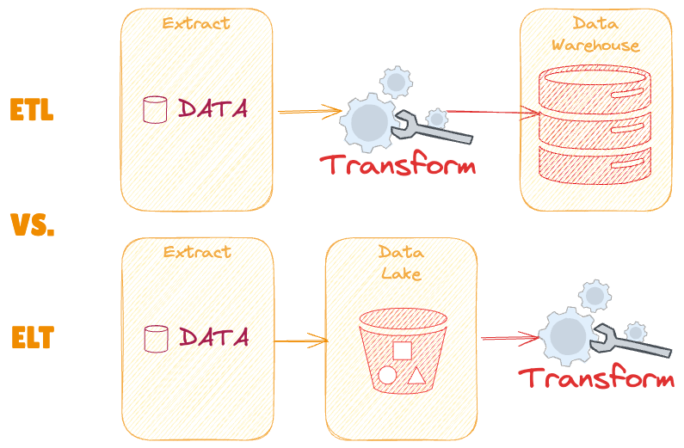
ETL vs. ELT
ETL: Data is transformed before loading into the data warehouse.
ELT: Data is loaded first, and then transformations are applied.
Discussion: When to choose ETL over ELT and vice versa?
DATATECH LABS.

Slide 11

Best Practices in ETL
Maintain a robust logging mechanism.
Implement retry mechanisms.
Ensure data validation at each stage.
Automate, automate, automate
Use parallel processing
DATATECH LABS.

Slide 12
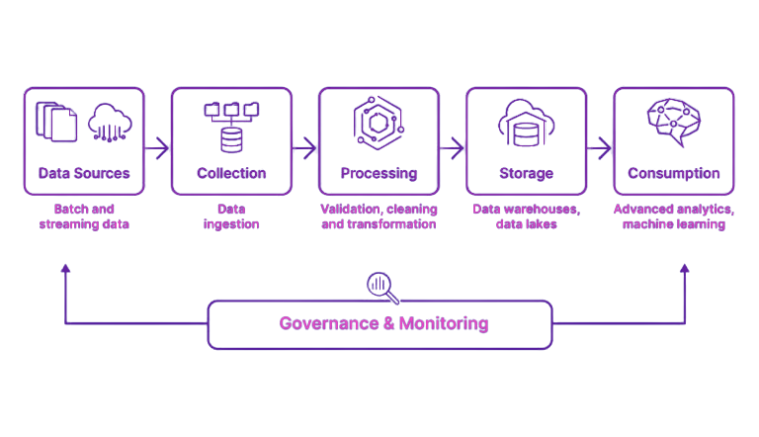
Data Pipeline Design
Definition: A data pipeline is a series of data processing steps that collect raw data from different sources, process it, and deliver it to a destination system.
Pipeline Stages:
Ingestion: Collecting raw data from various sources.
Processing: Transforming the data into a usable format.
Storage: Storing the processed data in a data warehouse, database, or data lake.
Analysis (Consumption): Making the data available for analysis and reporting.
DATATECH LABS.

Slide 13
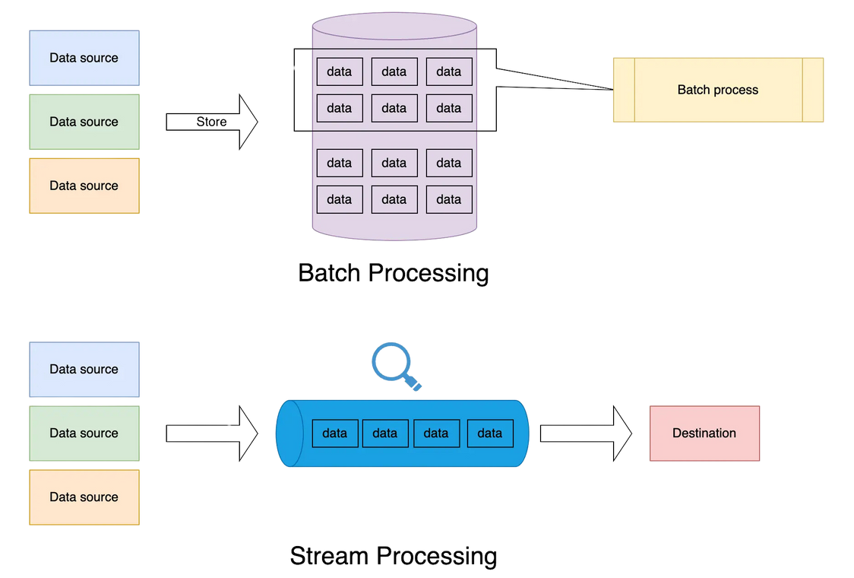
Batch vs. Streaming Data Pipelines
Batch Processing: Collecting and processing data in large blocks at scheduled intervals.
Process data in chunks (Daily reports, weekly analytics).
Typically run at scheduled intervals
Suitable for large volumes of data
Streaming Processing: Processing data as it is generated, providing immediate insights (Real-time monitoring, fraud detection).
Process data in real-time or near real-time
Continuous data flow
Low-latency processing
Lambda architecture (combination of batch and streaming)
DATATECH LABS.

Slide 14

Data Pipeline Best Practices
Modularity and reusability
Error handling and logging
Monitoring and alerting
Scalability and performance optimization
Data quality checks
Version control and documentation
DATATECH LABS.

Slide 15

Case Study: ETL in a Retail Environment
Scenario:
A retail company needs to integrate data from online sales, physical stores, and customer feedback systems.
Discussion Point: How would you design an ETL pipeline for this scenario?
DATATECH LABS.

Slide 16
Challenges in ETL Processes
Data Quality Issues
Handling Large Volumes of Data
Managing Multiple Data Sources
Discussion Point: How can these challenges be mitigated in a production environment?
DATATECH LABS.

Slide 17
Hands-on:
Implementing ETL Pipeline.
DATATECH LABS.

Slide 18
Q&A and Discussion
DATATECH LABS.

Slide 19
Big Data Technologies and Ecosystems
DATATECH LABS.

Slide 20
Introduction to
BIG DATA
DATATECH LABS.

Slide 21
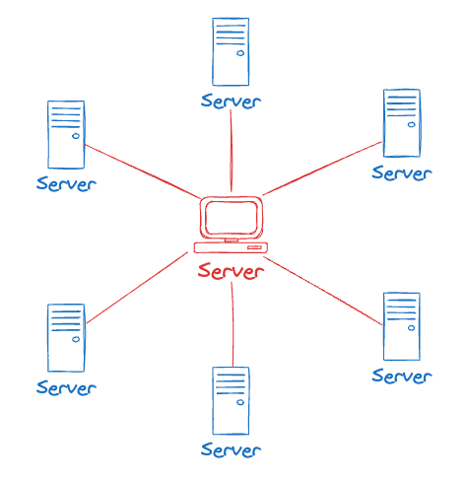
Introduction to Distributed Computing
Definition: A model in which components of a software system are shared among multiple computers to improve efficiency and performance.
Why Distributed Computing?
Handle large-scale data processing
Improve fault tolerance and reliability
Enable parallel processing
Provide scalability
DATATECH LABS.

Slide 22
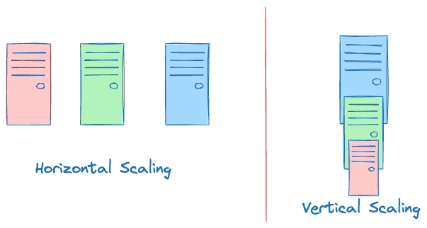
Key Concepts & Scalability in Distributed Computing
Key Concepts:
Scalability
Fault tolerance
Consistency
Availability
Partition tolerance
Scaling methods:
Vertical scaling (scale-up)
Horizontal scaling (scale-out)
DATATECH LABS.

Slide 23

Challenges in Distributed Computing
Network latency
Synchronization
Partial failures
Consistency maintenance
Load balancing
DATATECH LABS.

Slide 24
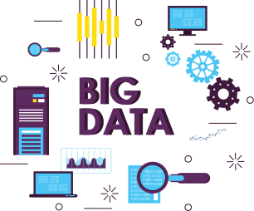
Introduction to Big Data
Definition: Big Data refers to the vast volumes of data generated by various sources that are too large, complex, and dynamic for traditional data processing tools.
Overview of the components of a big data ecosystem:
Data sources
Ingestion
Processing
Storage
And analysis.
DATATECH LABS.

Slide 25
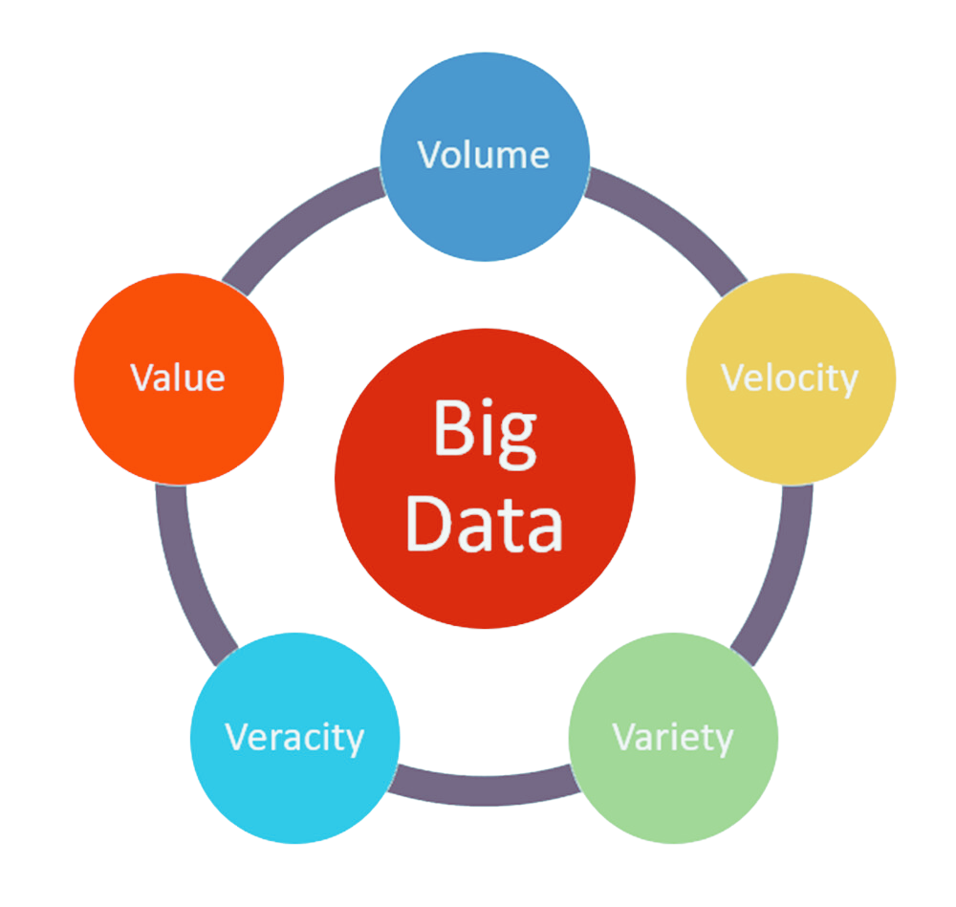
The Big Data Ecosystem
Explanation: Discuss the 5 V’s of Big Data:
Volume
Velocity
Variety
Veracity
Value
DATATECH LABS.

Slide 26
Introduction to Hadoop
DATATECH LABS.

Slide 27




Hadoop Ecosystem Overview
Hadoop is an open-source framework for distributed storage and processing of large data sets.
Components:
HDFS: Hadoop Distributed File System.
MapReduce: A programming model for processing large data sets.
YARN: Yet Another Resource Negotiator, manages cluster resources.
Map Reduce
Yarn
HDFS
DATATECH LABS.

Slide 28
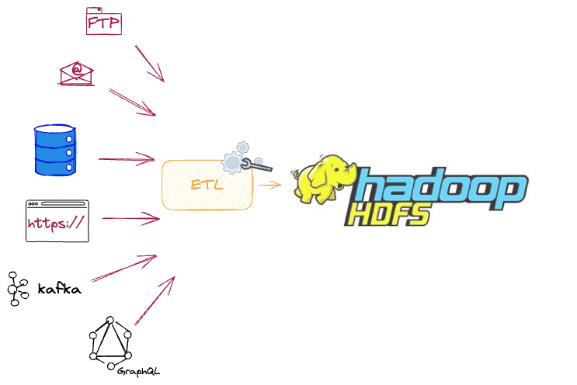
HDFS: The Storage Backbone
HDFS is designed to store very large files across multiple machines. It is a distributed storage system for big data
Data is split into blocks and distributed across the cluster.
Architecture:
NameNode (manages filesystem namespace)
DataNodes (store actual data)
DATATECH LABS.

Slide 29
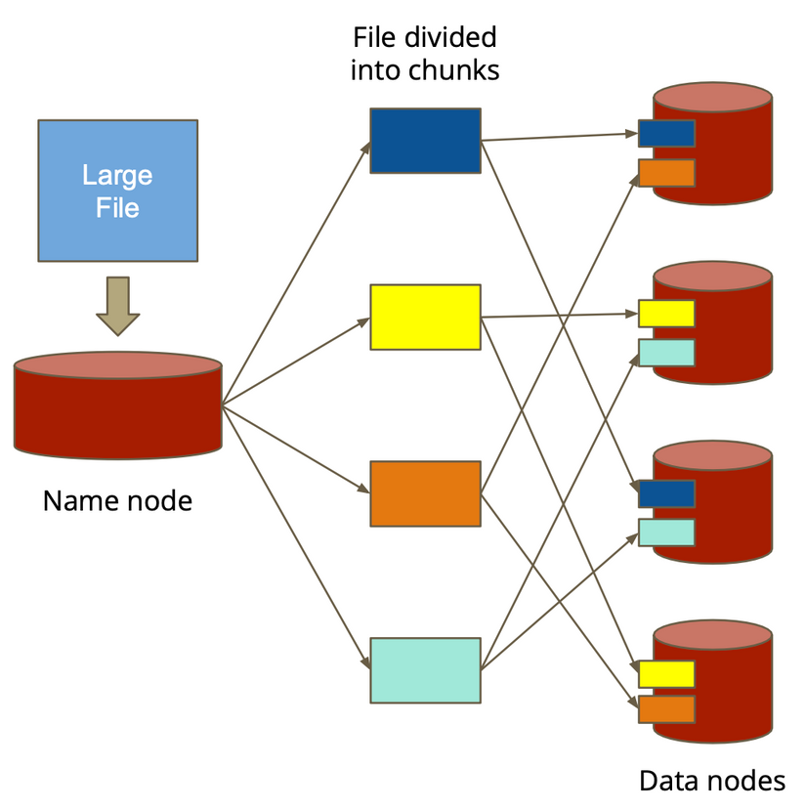
HDFS Features
Large file storage
Streaming data access
Fault tolerance
Portability across heterogeneous hardware and software platforms
DATATECH LABS.

Slide 30
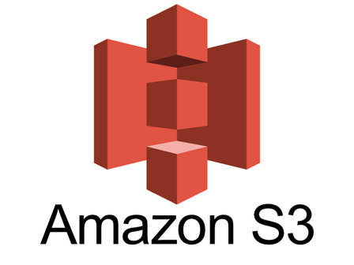
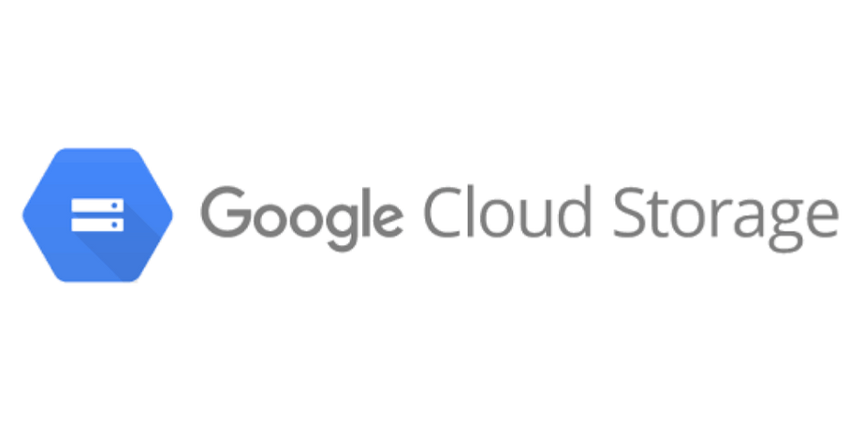
Big Data Storage Solutions
On-premise:
HDFS: Hadoop’s distributed file system.
Cloud-based:
Amazon S3: Cloud storage service.
Google Cloud Storage: Object storage service.
DATATECH LABS.

Slide 31
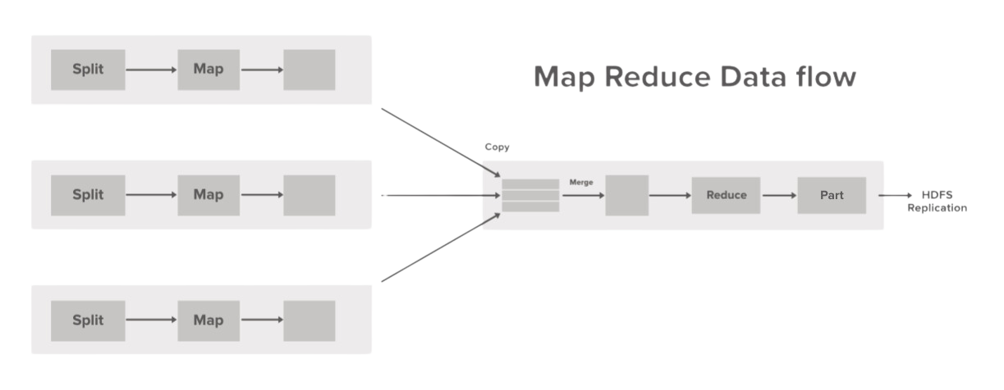
MapReduce: Distributed Data Processing
Programming model for processing large data sets.
Two main tasks (steps):
Map Phase: Processes input data and generates key-value pairs.
Reduce Phase: Aggregates key-value pairs to produce the final output.
DATATECH LABS.

Slide 32
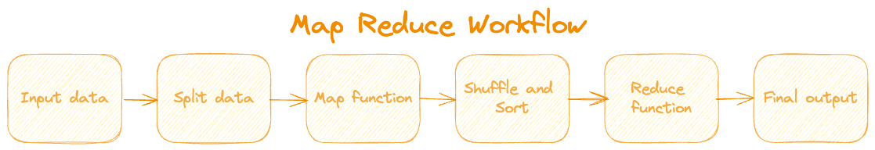
MapReduce Workflow
Input data
Split data
Map function
Shuffle and Sort
Reduce function
Final output
DATATECH LABS.

Slide 33
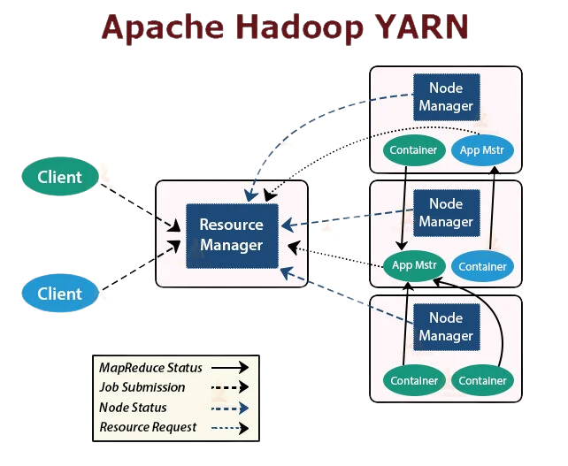
YARN: Resource Management in Hadoop
YARN: “Yet Another Resource Negotiator”
Cluster resource management and job scheduling. Means resource allocations for different applications.
Components:
ResourceManager: Global resource scheduler
NodeManager: Per-node agent
ApplicationMaster: Per-application manager
DATATECH LABS.

Slide 34
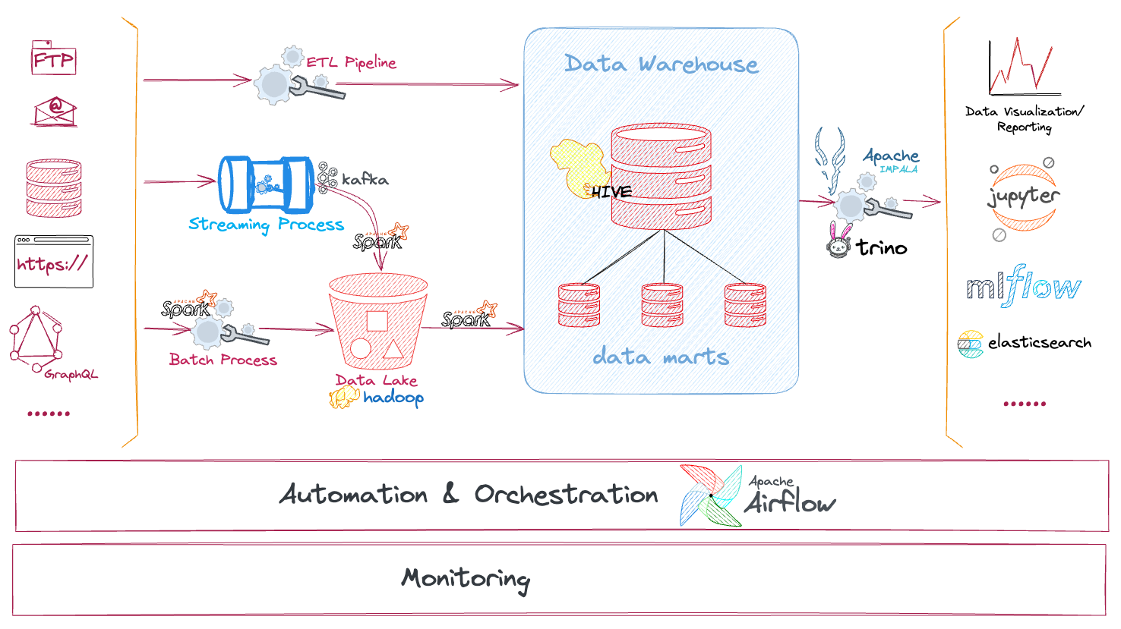
Hadoop Ecosystem
Hive: SQL-like queries
HBase: NoSQL database
Spark: In-memory data processing
Kafka: Distributed streaming platform
Pig: High-level data flow language
DATATECH LABS.

Slide 35

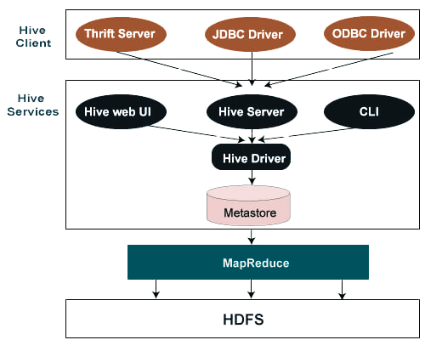
Big Data Warehousing
Apache Hive is a data warehouse infrastructure built on top of Hadoop.
Features:
SQL-like query language (HiveQL).
Supports complex queries on large datasets.
DATATECH LABS.

Slide 36

NoSQL Database in Hadoop Ecosystem
Apache HBase is a distributed, scalable, NoSQL database built on top of HDFS.
Features:
Real-time read/write access to large datasets.
DATATECH LABS.

Slide 37

Apache Spark: In-Memory Data Processing
Introduction: Spark is a fast, in-memory data processing engine that allows for real-time analytics.
Spark vs. Hadoop:
Hadoop MapReduce: Disk-based processing, suited for batch processing.
Apache Spark: In-memory processing, suited for both batch and real-time processing.
DATATECH LABS.

Slide 38

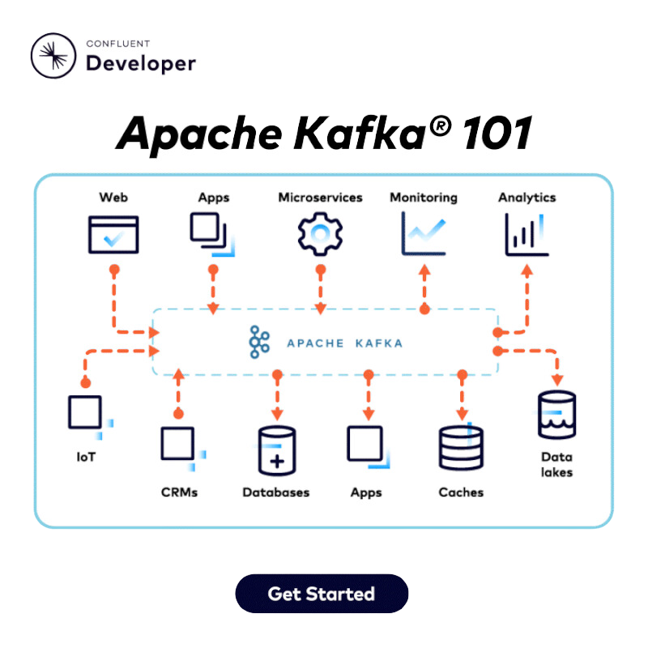
Apache Kafka: Distributed Streaming Platform
Kafka is a distributed streaming platform for building real-time data pipelines.
Components:
Producers: Publish messages to Kafka topics.
Consumers: Subscribe to Kafka topics to process messages.
DATATECH LABS.

Slide 39

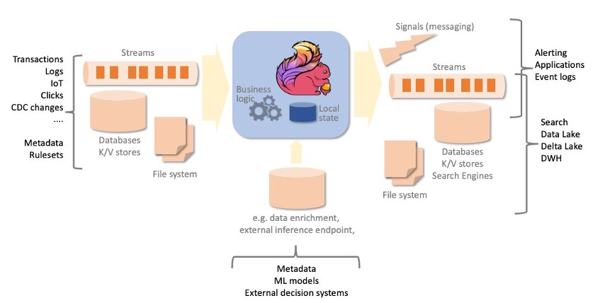
Apache Flink: Real-Time Stream Processing
Flink is a stream processing framework for real-time data processing.
Features:
Stateful computation, low-latency processing.
Event-driven applications
DATATECH LABS.

Slide 40
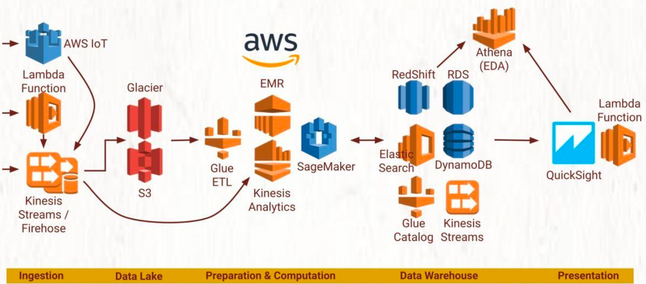
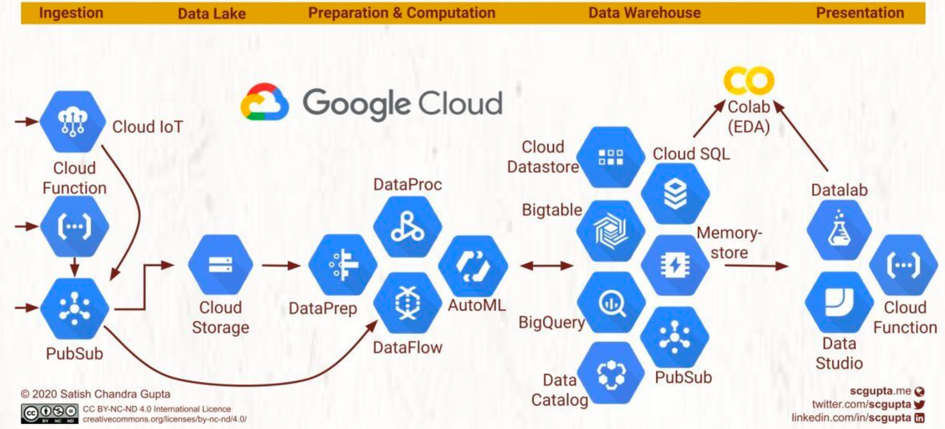
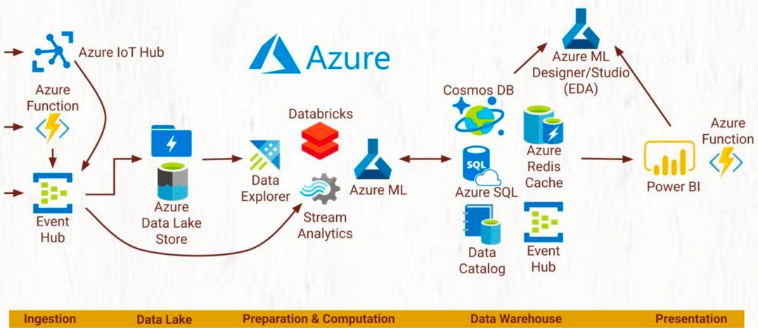
Big Data on-Cloud Services
Cloud Computing providers (ex: AWS, GCP, MS Azure) often utilize a “software as a service” model to allow customers to easily process normal and big data.
DATATECH LABS.

Slide 41
Hands-on:
Set up a Hadoop cluster on your local machine.
Implement a MapReduce job to process data on HDFS.
DATATECH LABS.

Slide 42
Apache Spark
DATATECH LABS.

Slide 43
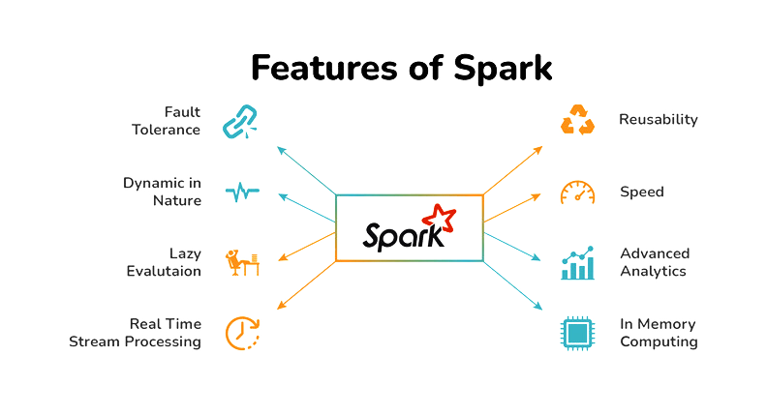
Introduction to Apache Spark
Key features:
In-memory computation
Fault tolerance
Lazy evaluation
Support for multiple languages (Scala, Java, Python, R)
DATATECH LABS.

Slide 44
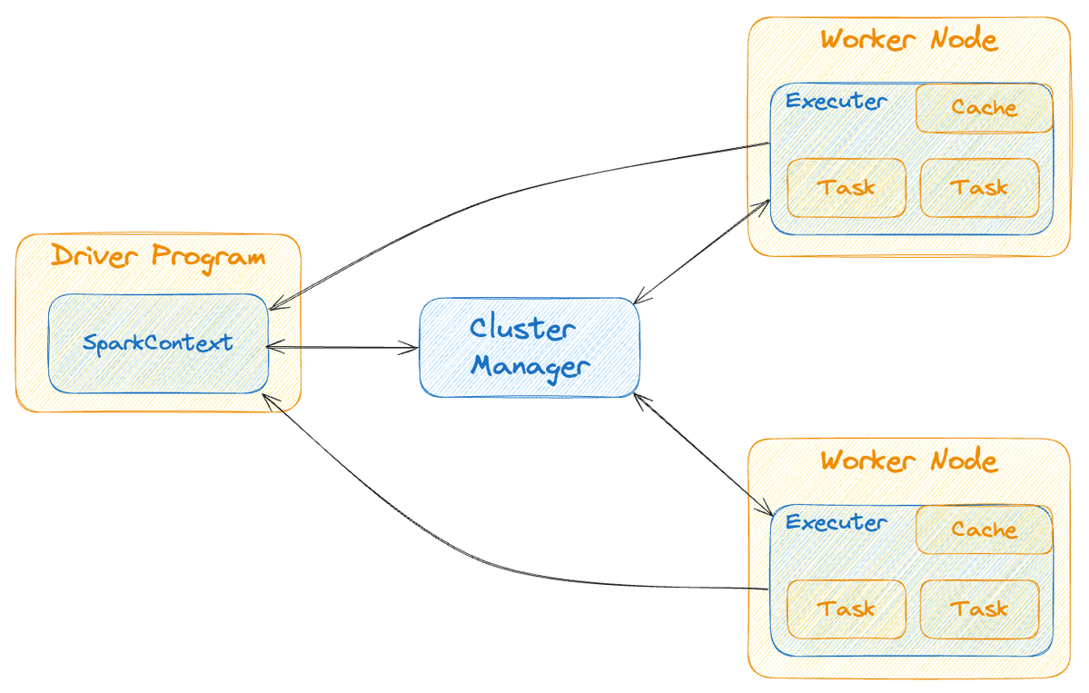
Spark Architecture
Driver Program
Cluster Manager
Worker Nodes
Executors
DATATECH LABS.

Slide 45
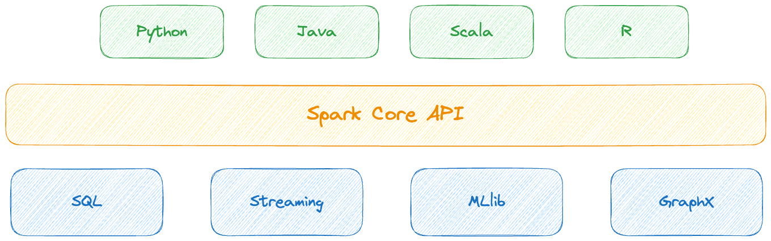
Spark Components
Spark Core
Spark SQL
Spark Streaming
MLlib (Machine Learning)
GraphX (Graph computation)
DATATECH LABS.

Slide 46
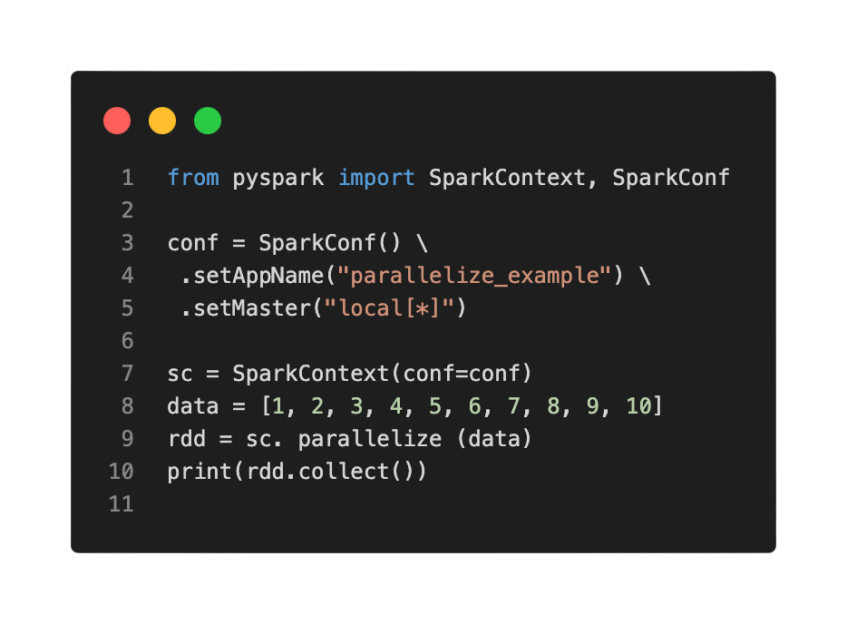
Spark RDDs (Resilient Distributed Datasets)
Definition: Fundamental data structure of Spark
Properties:
Immutable
Partitioned
Ability to be operated on in parallel
DATATECH LABS.

Slide 47
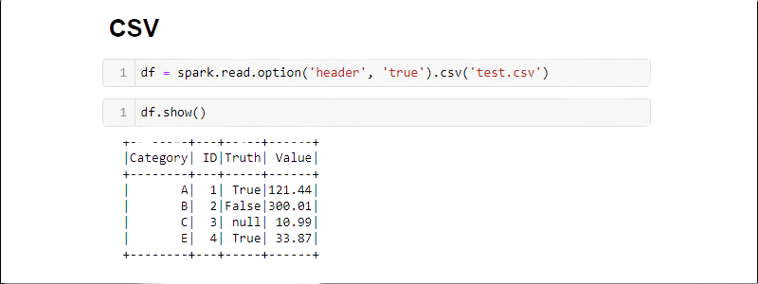
Spark DataFrames and Datasets
DataFrames: Distributed collection of data organized into named columns
Create by loading structured data from various sources like.
Perform operations similar to a SQL table by utilizing DataFrame APIs.
Benefit from the optimization techniques incorporated within DataFrames.
Datasets:
Perfect for complex operations.
It combines the advantages of RDDs and DataFrames.
It excels efficiently at grouping data.
DATATECH LABS.

Slide 48
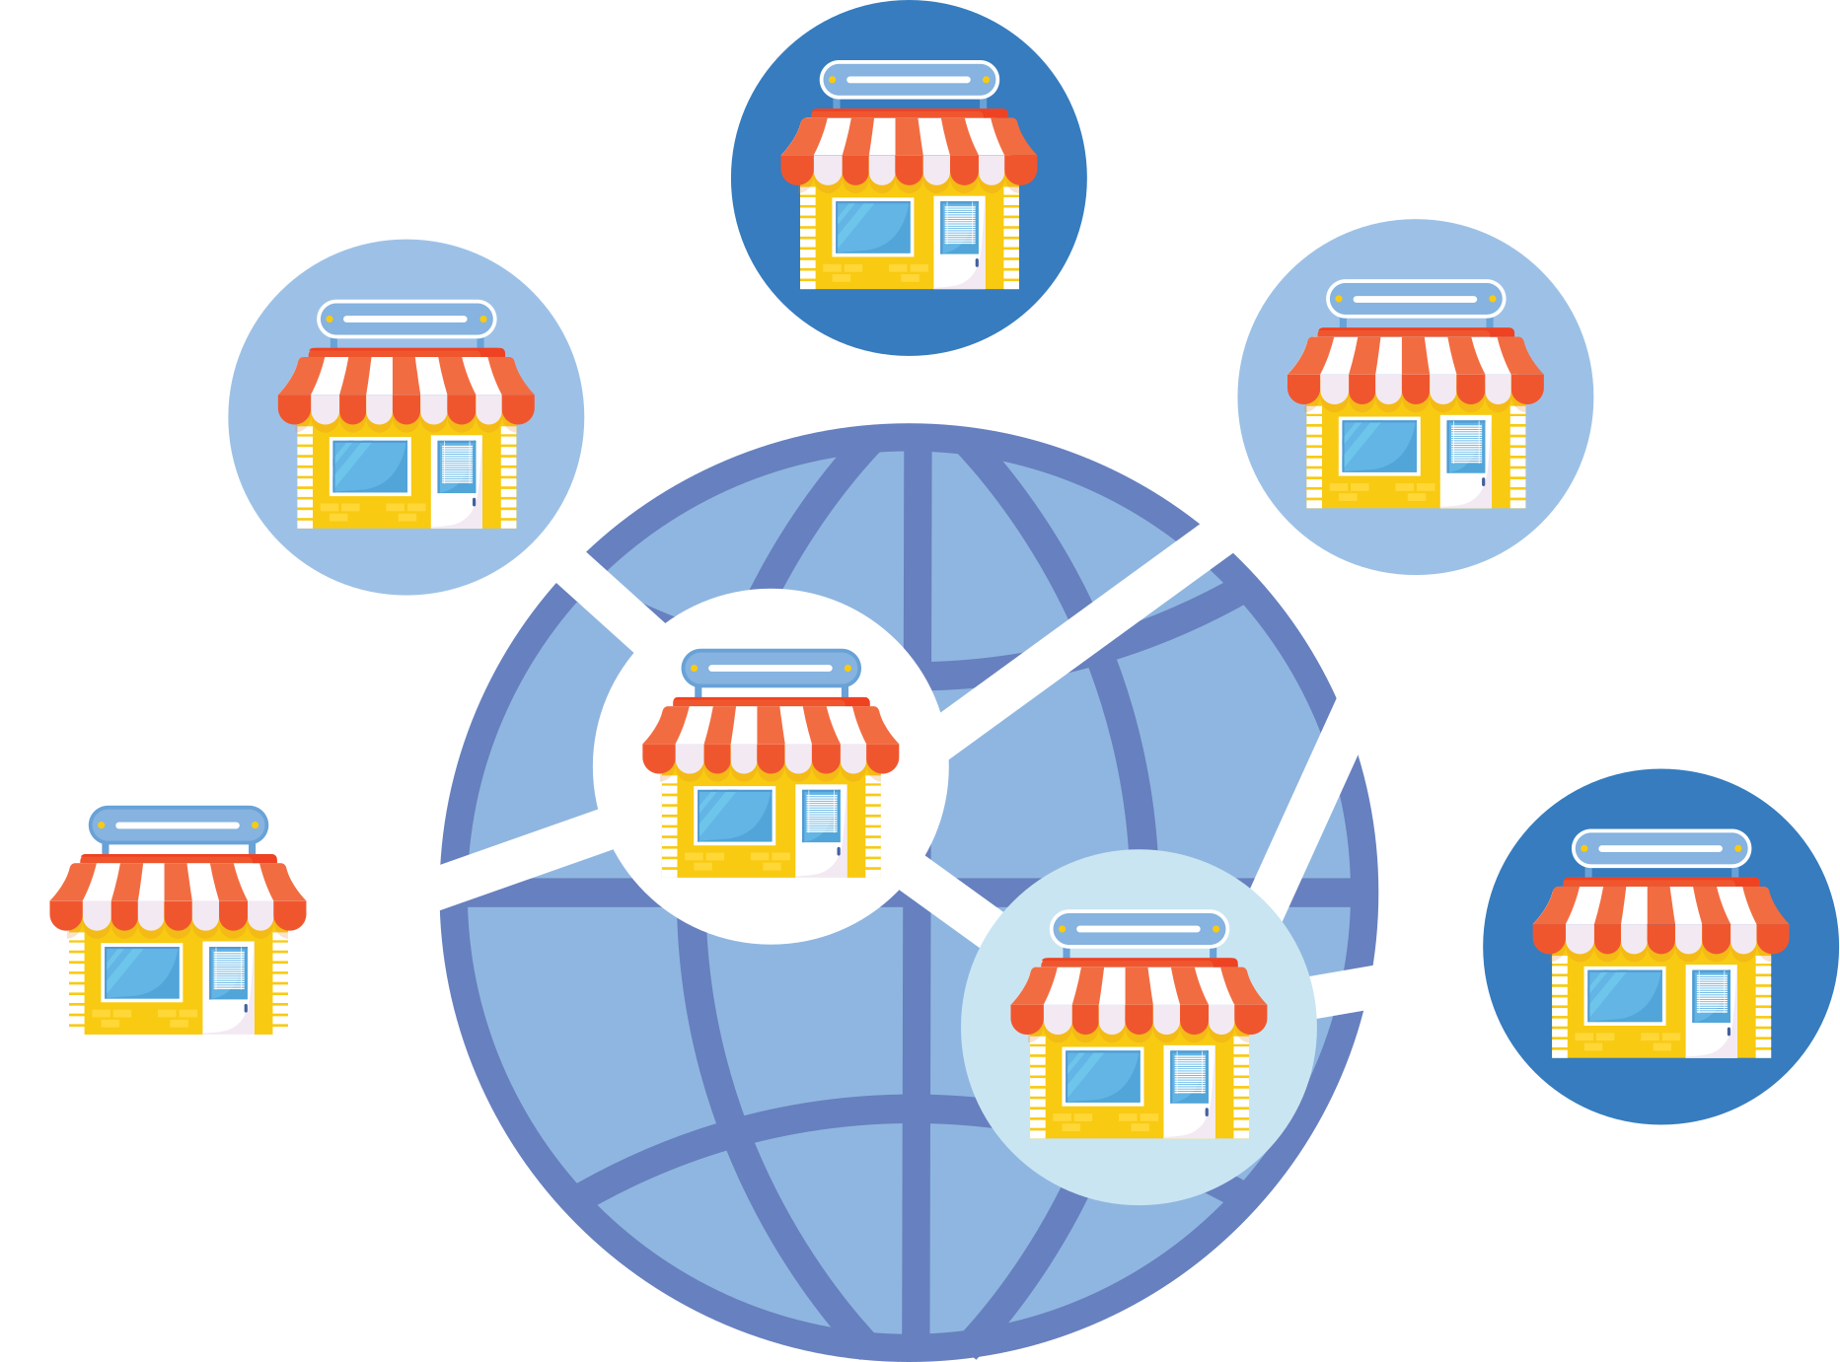
Case Study: Building a Big Data Ecosystem
Scenario:
Setting up a big data ecosystem for a retail business.
Discussion: Components required and the tools to be used.
DATATECH LABS.

Slide 49
Best Practices in Big Data Engineering
Optimize storage and processing costs.
Ensure data security and privacy.
Monitor and maintain data pipelines.
Discussion: Challenges in implementing best practices in big data.
DATATECH LABS.

Slide 50
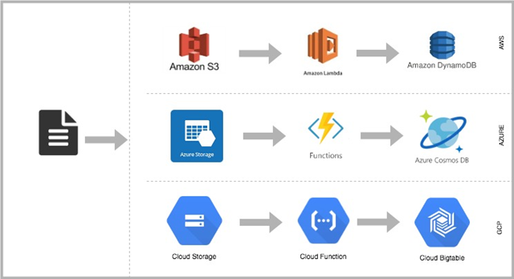
Emerging Big Data Trends
Real-time analytics.
Serverless big data processing.
Serverless big data processing
DATATECH LABS.

Slide 51
Hands-on:
Spark Basics
DATATECH LABS.

Slide 52
Q&A and Discussion
DATATECH LABS.

Slide 53

MEET OUR TEAM
Omar AlSaghier
Sr. Data Engineer
DATATECH LABS.

Slide 54







DATATECH LABS.
THANK YOU
OUR CONTACT
DataTechLabs
datatechlabs.ai@gmail.com
datatechlabs.ai
Amman, Jordan

